Slide 1

Image captioning

Slide 2
Team Details
B Hari Krishna 2203A52006
N Jeshwanth 2203A52043
J Uday Kiran 2203A52028
K Aniritha 2203A52032

Slide 3

I Image Captioning bridges the gap between visual understanding and language generation. Uses techniques to understand image content and models to form sentences. Used in accessibility tools, content organization, and smart assistants. Requires understanding the image and forming accurate and relevant descriptions. Makes visual content more accessible and helps in automating tasks like tagging and organizing images.

Slide 4
Understanding Complexity: Generating accurate and meaningful captions for images is challenging due to: Complex scenes with multiple objects. Relationships and interactions between objects that need contextual understanding. Limitations of Current Methods: Difficulty in producing coherent and contextually relevant sentences. Impact on Real-World Applications: Limited use in accessibility tools for visually impaired individuals. Challenges in automating tasks like content moderation and multimedia search.

Slide 5

Objectives

Slide 6
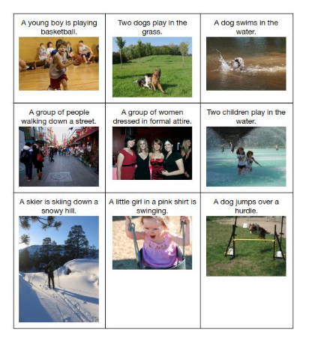
Develop a deep learning model for generating image captions. 2.Improve accuracy using advanced neural network architectures. 3.Test the model on real-world datasets (e.g., Flickr8k, MS COCO). 4.Provide a user-friendly system for practical applications. Visual: Use a checklist-style layout with an AI-themed icon or image.

Slide 7
Data visualization for captions
Before data preprocessing
After data preprocessing
Visualizing word frequencies, common phrases, or sentence lengths helps identify patterns in the captions.
Comparing predicted captions to actual captions using visual tools like tables, confusion matrices, or similarity graphs helps evaluate the model's accuracy.
Dataset: flickr8k
Code: harikrishnaaa321/imageCaptioning.git

Slide 8
Approaches

Slide 9
CNN (Inception Net) + LSTM
Overview:
Extract image features using Inception Net (CNN).
Generate captions sequentially using LSTM, which captures temporal dependencies in language.
Advantages:
Effective for small-scale datasets.
Handles sequential text generation well.
Limitations:
Slower due to sequential processing.
Struggles with long, complex sentences.

Slide 10
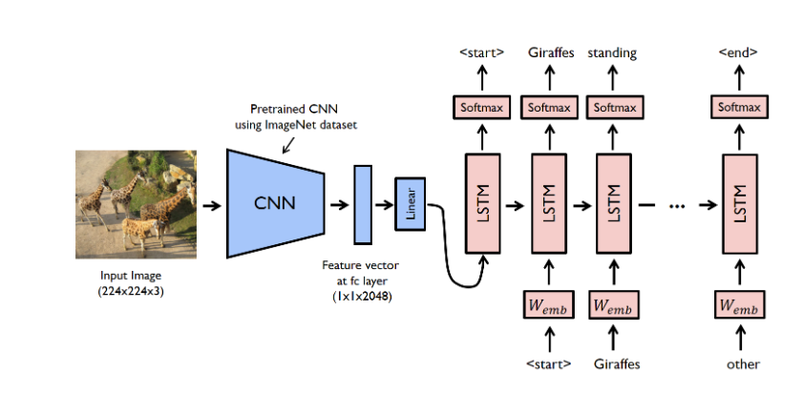
Inception Net + LSTM
Starts with an Input Layer for image features.
Passes through Batch Normalization to normalize these features.
Dense Layer transforms the image features, followed by another Batch Normalization for refinement.
Embedding Layer converts each word in the caption into dense vector form.
LSTM Layer processes the sequential information of the caption, with a Not Equal layer applied for masking padding tokens.
The combined features pass through two Dense Layers to generate the final output, which represents the predicted caption.
CNN+LSTM ARCHITECTURE

Slide 11
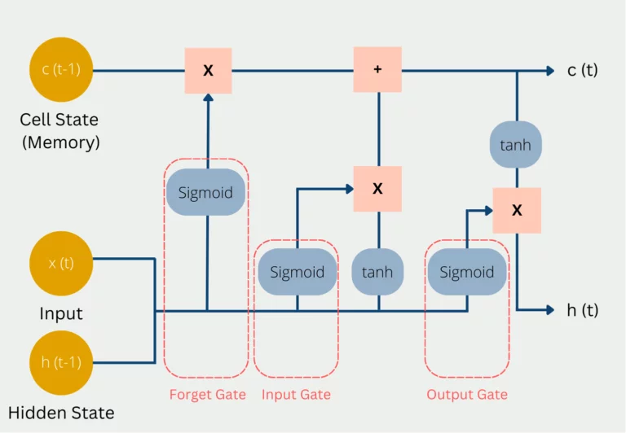
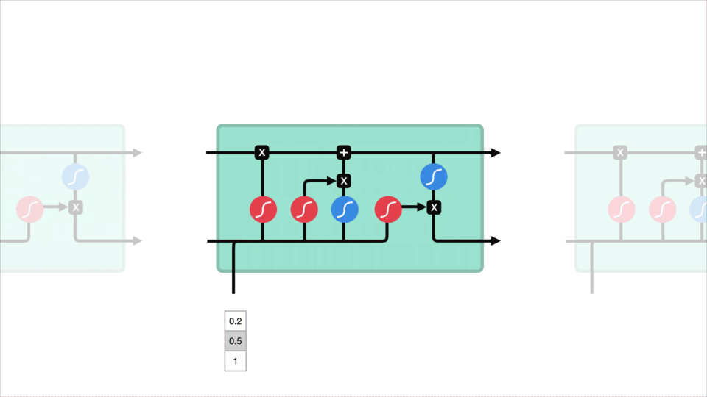
Memory Cells:
LSTMs use memory cells to retain long-term dependencies
in sequential data.
2. Gate Mechanism:
Forget, Input, and Output gates regulate information flow.
3. Cell State:
Maintains and updates long-term information, solving vanishing gradient issues.
4. Applications:
Ideal for tasks like NLP, speech recognition, and time-series prediction.

Slide 12
CNN (Res Net) + Transformer
Overview:
Extract robust image embeddings using Res Net (CNN).
Generate captions using the Transformer, leveraging self-attention for better context understanding and parallel processing.
Advantages:
Faster and scalable due to parallelized processing.
Handles complex captions and long-range dependencies effectively.
Limitations:
Higher computational requirements.
Res Net for Image Feature Extraction:
Res Net (Residual Network) is a deep Convolutional Neural Network (CNN) used to extract detailed features from images.
Res Net uses residual connections to allow information to skip layers, helping the model handle very deep networks without losing information or causing vanishing gradients.
It processes the image and outputs a compact feature representation, which captures key visual elements needed for captioning.

Slide 13
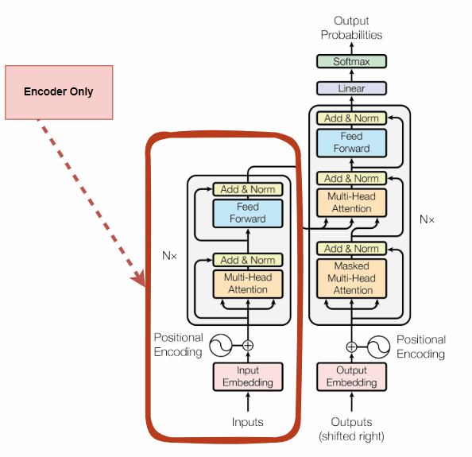
Res Net + Transformer
Transformer for Sequence Modeling:
Transformers are advanced sequence models that use self-attention mechanisms to understand the relationships between different parts of a sequence (in this case, words in a caption).
The Transformer takes the Res Net features as input and generates a caption by focusing on relevant parts of the image while producing each word.
Unlike LSTMs, Transformers can model long-range dependencies without needing to process information sequentially, making them faster and more effective at capturing complex relationships.

Slide 14
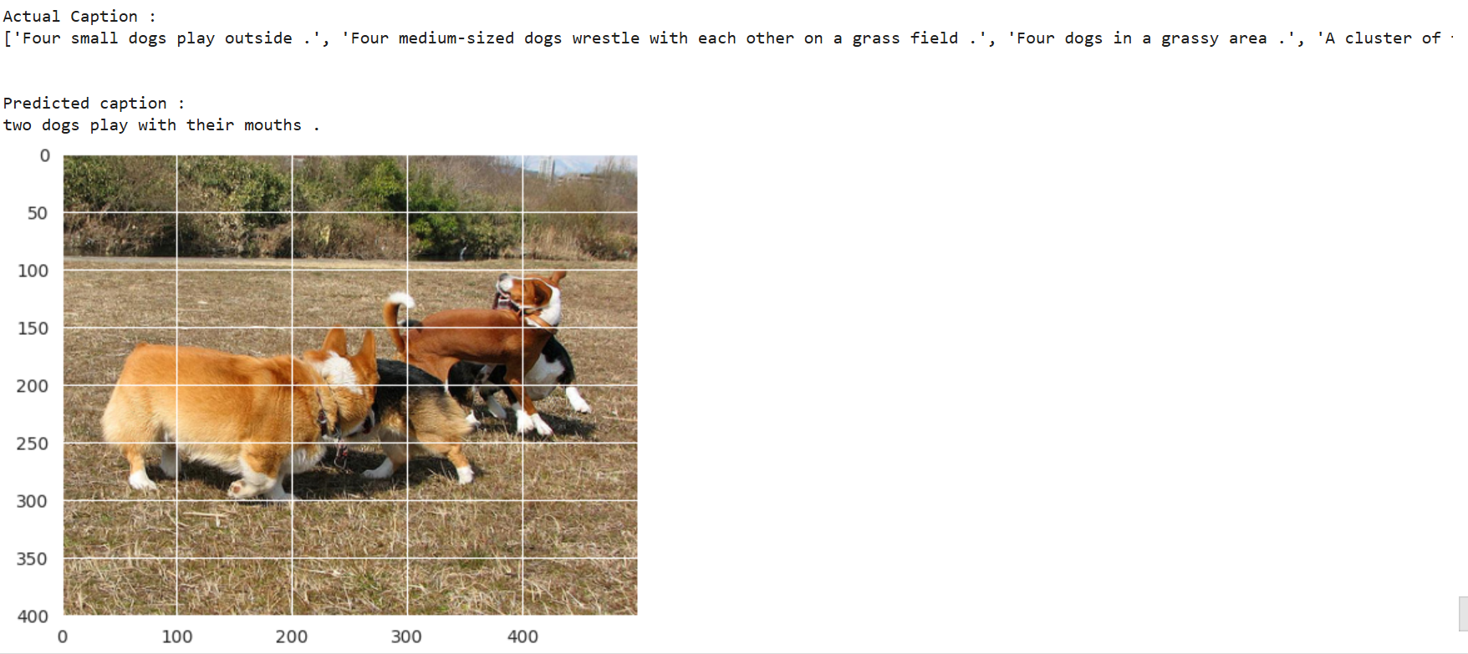
LSTM vs Transformers
Enhanced Dependencies:
Transformers capture complex word relationships better than LSTMs, improving contextual accuracy.
Faster Training:
Transformers process words in parallel, reducing training and inference times.
Attention Mechanism:
Multi-head attention improves focus on relevant image areas, enhancing caption relevance.
Better Caption Quality:
Transformers create fluent and coherent captions, outperforming
LSTMs in complex scenarios.
Data Dependency: Transformers excel with large datasets, while LSTMs are effective for smaller datasets due to simpler architecture.

Slide 15
Results

Slide 16
Metrics used
1. BLEU as a Quality Metric: BLEU evaluates how closely generated captions match human-written ones, making it ideal for tasks like image captioning.
2. Loss: Measures the model's prediction error during training, helping to minimize the difference between predicted and actual captions, which guides model improvement.
3. Accuracy: Measures how often the model's generated captions correctly match the expected outputs, providing a direct evaluation of prediction correctness.

Slide 17
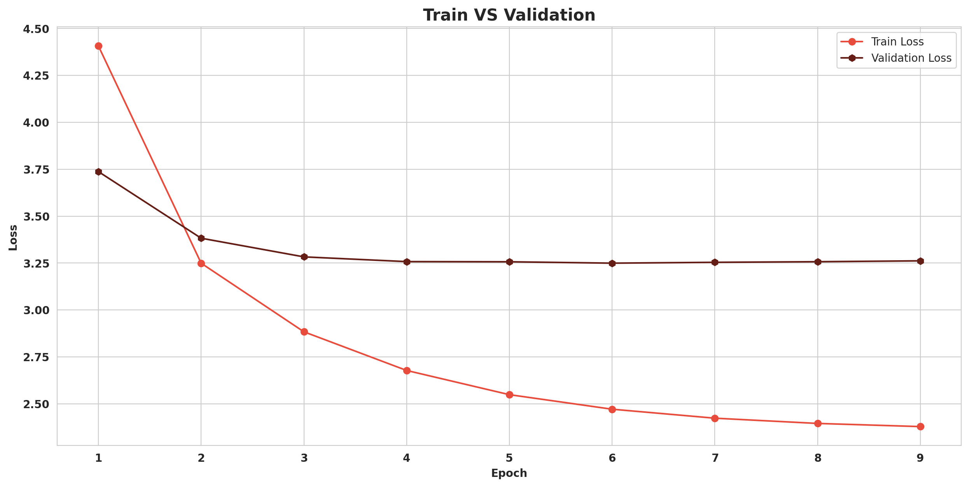
Training Loss Improvement: The training loss shows a consistent decrease, indicating the model's learning progress over epochs.
Validation Loss Stability: After an initial decrease, the validation loss stabilizes, showing that the model is reaching a reliable performance on unseen data.
Significant Early Learning: Most of the improvement in both training and validation loss happens in the first few epochs, highlighting rapid early learning.
Model Consistency: The stable validation loss after early epochs suggests a consistent performance level when handling new data.

Slide 18
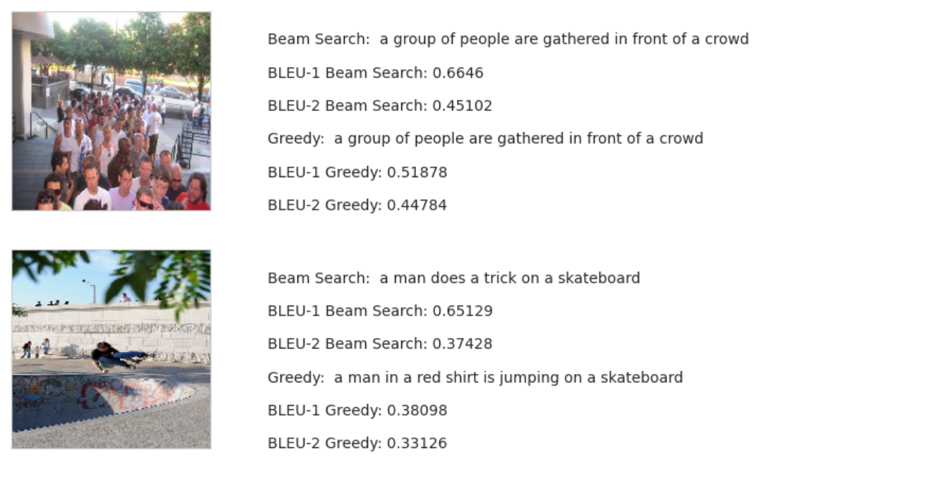
Beam Search vs. Greedy Search:
Beam Search provides more accurate and coherent captions with higher BLEU scores, capturing context better than Greedy Search.
2. BLEU-1 and BLEU-2 Scores:
Higher BLEU-1 scores indicate accurate word choices. Lower BLEU-2 scores suggest room for improvement in word sequence accuracy.
3. Overall Insight:
Beam Search outperforms Greedy Search, producing captions that align more closely with expected descriptions.

Slide 19
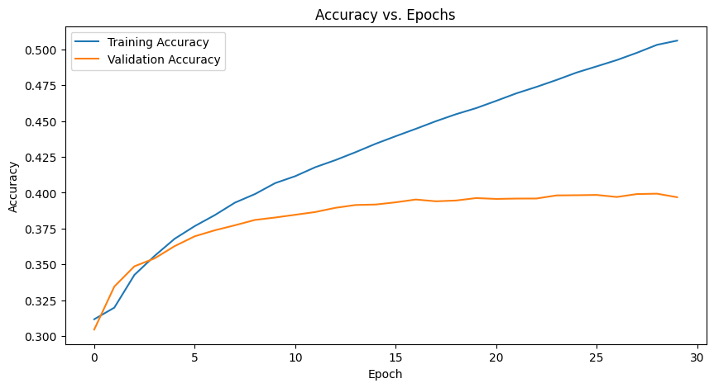
Training Accuracy Improvement:
Training accuracy steadily increases over epochs, indicating that the model is learning to make correct predictions on training data.
Validation Accuracy Stability:
After an initial increase, validation accuracy reaches a plateau, suggesting that the model is performing consistently well on unseen data.
Rapid Early Gains:
A significant increase in accuracy during the first few epochs shows the model learns quickly at the start.

Slide 20
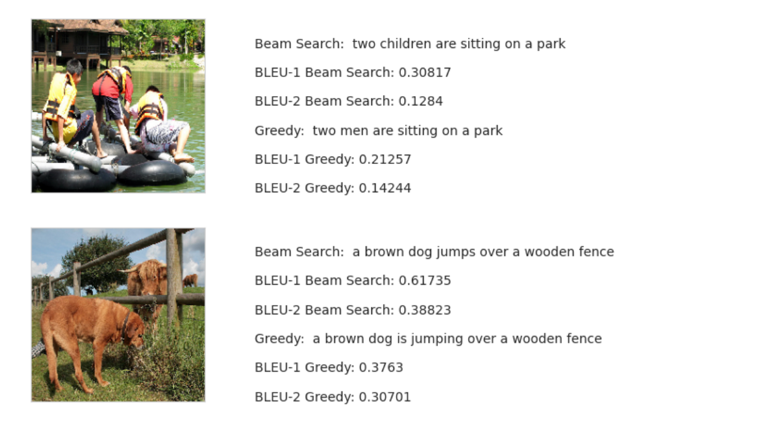
1. Beam Search:
Produces more accurate and descriptive captions with higher BLEU scores.
2. Greedy Search:
Captions are less accurate due to its single-path approach.
3. Scores:
Beam Search outperforms Greedy Search in BLEU-1 and BLEU-2 metrics.

Slide 21
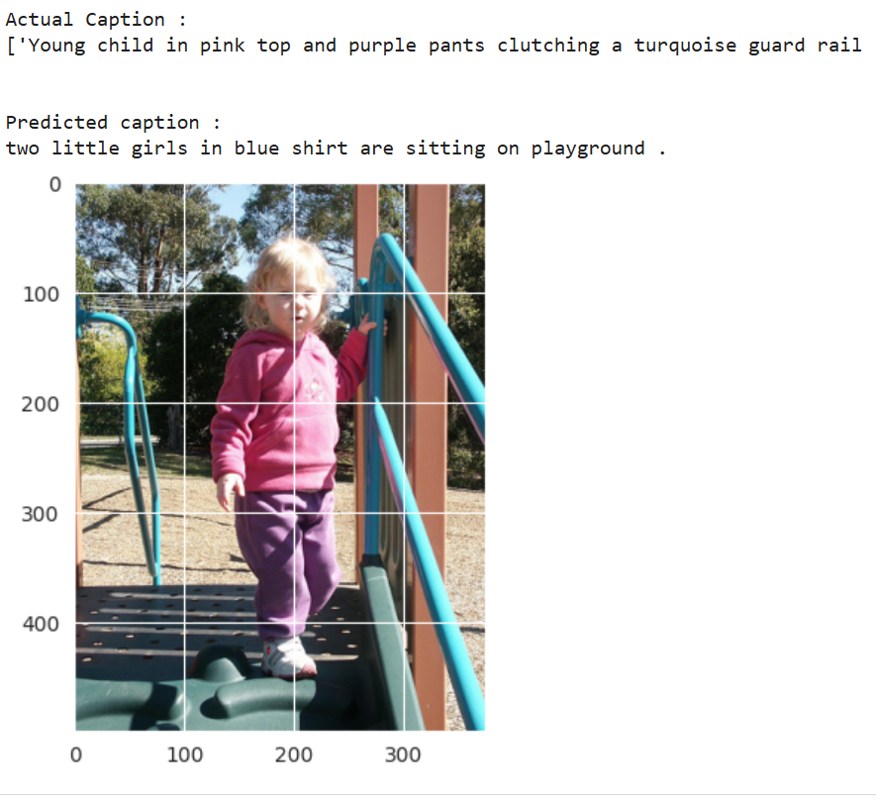
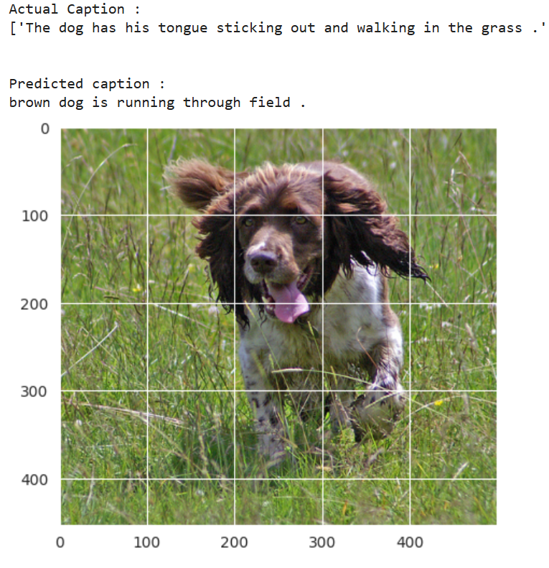
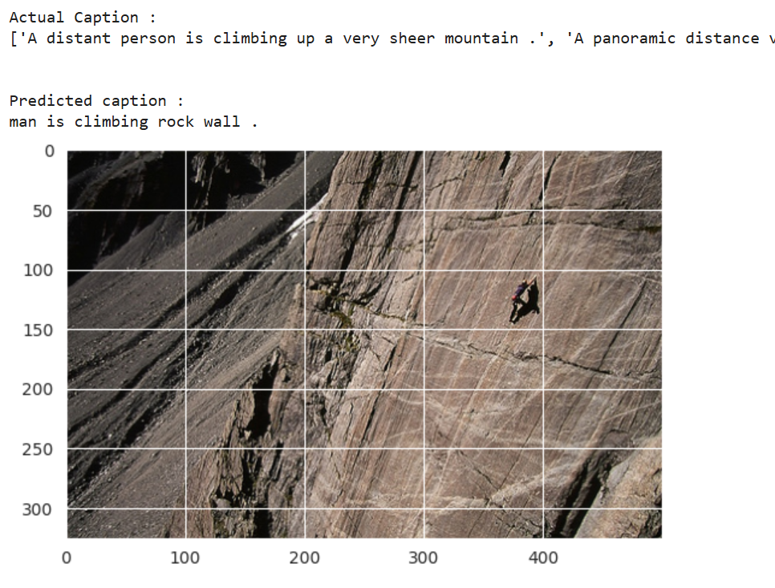
Predicted Captions

Slide 22
Conclusion
In conclusion, using a Transformer as a decoder outperforms the Inception + LSTM model for image captioning.
The Transformer’s ability to capture long-range dependencies, coupled with its efficient parallel processing and advanced attention mechanisms, leads to faster training, improved contextual accuracy, and higher-quality captions.
This makes Transformers a more effective choice for generating coherent and contextually relevant image descriptions.

Slide 23
Thank you

